Slide 1
Mathematics-I
MATH F111
Dr. Ashish Tiwari

Slide 2
Chap.15: Multiple Integrals

Slide 3
Double Integrals in Rectangular Coordinate
System (RCS)
(II) Double Integrals in Polar coordinate system
(PCS)
(III) Triple Integrals in Rectangular Coordinate
System
(IV) Triple Integrals in Cylindrical & spherical
Coordinate System
(V) Substitution in Multiple Integrals

Slide 4
15.1: Double Integrals in RCS
Let f(x,y) be a continuous function of two independent variables, x & y, defined on a closed region R.

Slide 5
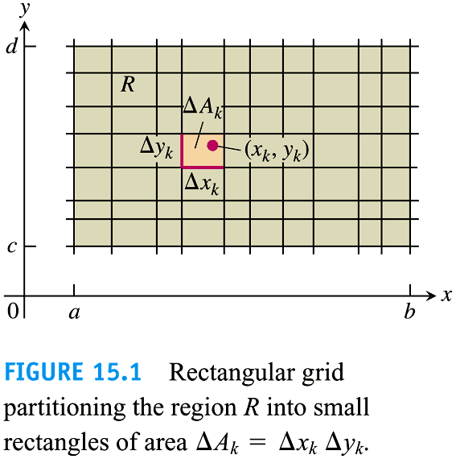

Slide 6
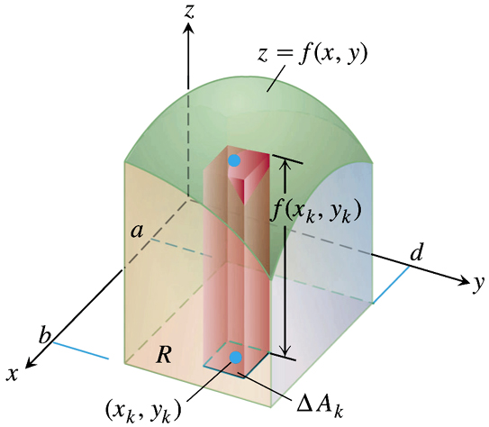
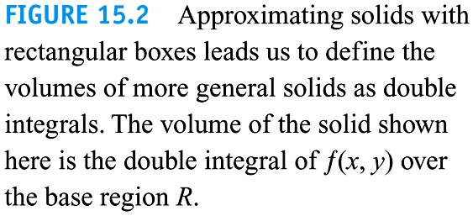
15.1: Double Integrals in RCS
Notes:
If w is differentiable and x, y, z are differentiable functions in t then w is also differentiable in t.

Slide 7
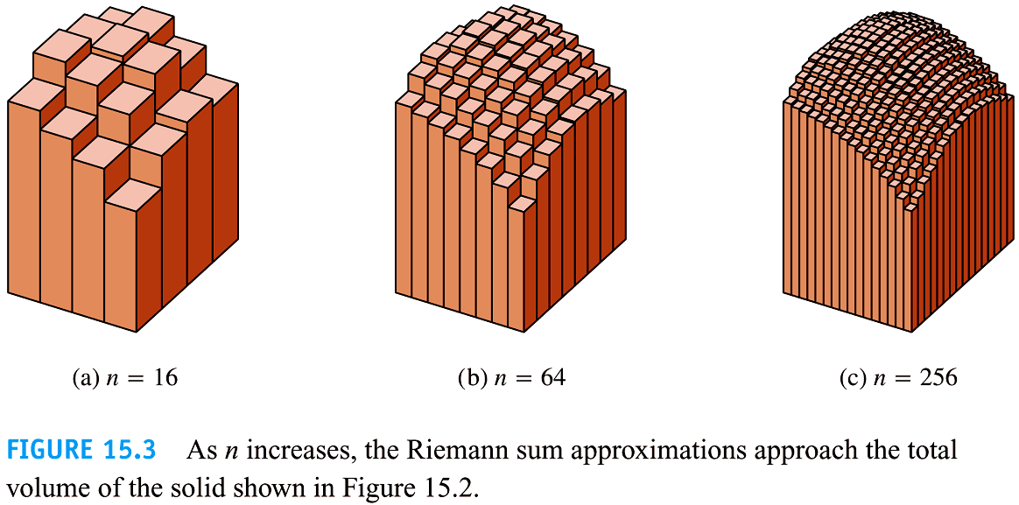
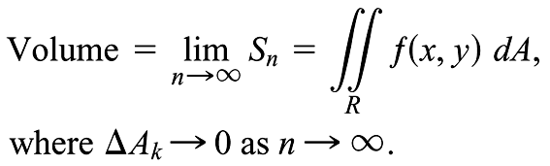
15.1: Double Integrals in RCS

Slide 8
15.1: Double Integrals in RCS

Slide 9
Remark

Slide 10
15.1: Double Integrals in RCS

Slide 11
15.1: Double Integrals in RCS

Slide 12
15.1: Double Integrals in RCS
Fubini’s Theorem for Calculating Double Integrals:
(I) Over rectangular region
(II) Over nonrectangular bounded region

Slide 13
15.1: Double Integrals in RCS (I) Over rectangular region
Don’t forget
to interchange
the limit
Iterated or repeated integral

Slide 14
15.1: Double Integrals in RCS (I) Over rectangular region

Slide 15
15.1: Double Integrals in RCS (II) Over nonrectangular region

Slide 16
15.1: Double Integrals in RCS (II) Over nonrectangular region

Slide 17
15.1: Double Integrals in RCS (II) Over nonrectangular region
Procedure to Find the Type of Region (IIA / IIB) for Integration
Step-1: Sketch the region of integration and label the boundary curves
Step-2:Limit of Integration for inner variable (say y)

Slide 18
Line parallel to y-axis through (x, 0) should meet R in a segment, the smallest value of y on it is g(x) and largest value of y on it is h(x) and such segments cover whole region R for
a≤ x ≤ b
Step-3: Limit of Integration for Outer variable (say x)

Slide 19
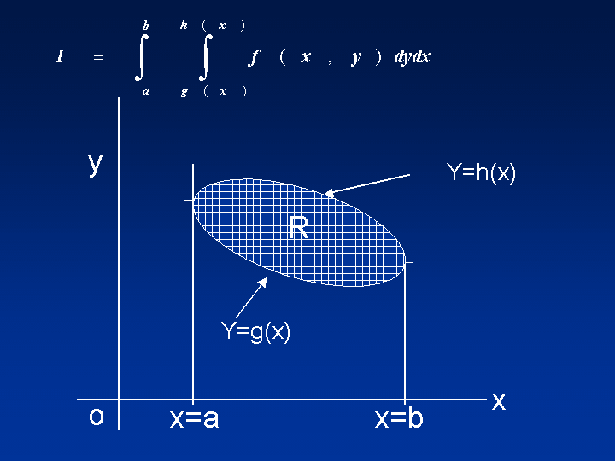
15.1: Double Integrals in RCS (II) Over nonrectangular region
i.e. find smallest and largest value of x for which the interval (for x) includes all the lines covering the whole region of integration

Slide 20
Q. Find the area bounded by parabola y=x² – 4
and straight line y=x+2.
Sol:
Limits of integration x² – 4≤ y ≤ x+2
-2 ≤ x ≤ 3
which is type-IIA

Slide 21
15.1: Double Integrals in RCS (II) Over nonrectangular region

Slide 22
15.1: Double Integrals in RCS (II) Over nonrectangular region

Slide 23
15.1: Double Integrals in RCS (II) Over nonrectangular region
Evaluated the area enclosed
by the curves y = x² – 4 and y = x + 2
using IIB type (y-range constant)

Slide 24
15.1: Double Integrals in RCS (II) Over nonrectangular region
I
II

Slide 25
Change of order of integration:

Slide 26
Change of order of integration:
Step-1: With the help of the limits given in the integral draw the region of integration.
Step-2: Now from the region of integration write the limits w.r.t the new order of integration as described in the procedure.

Slide 29
Evaluation of Volume: by double integral

Slide 33
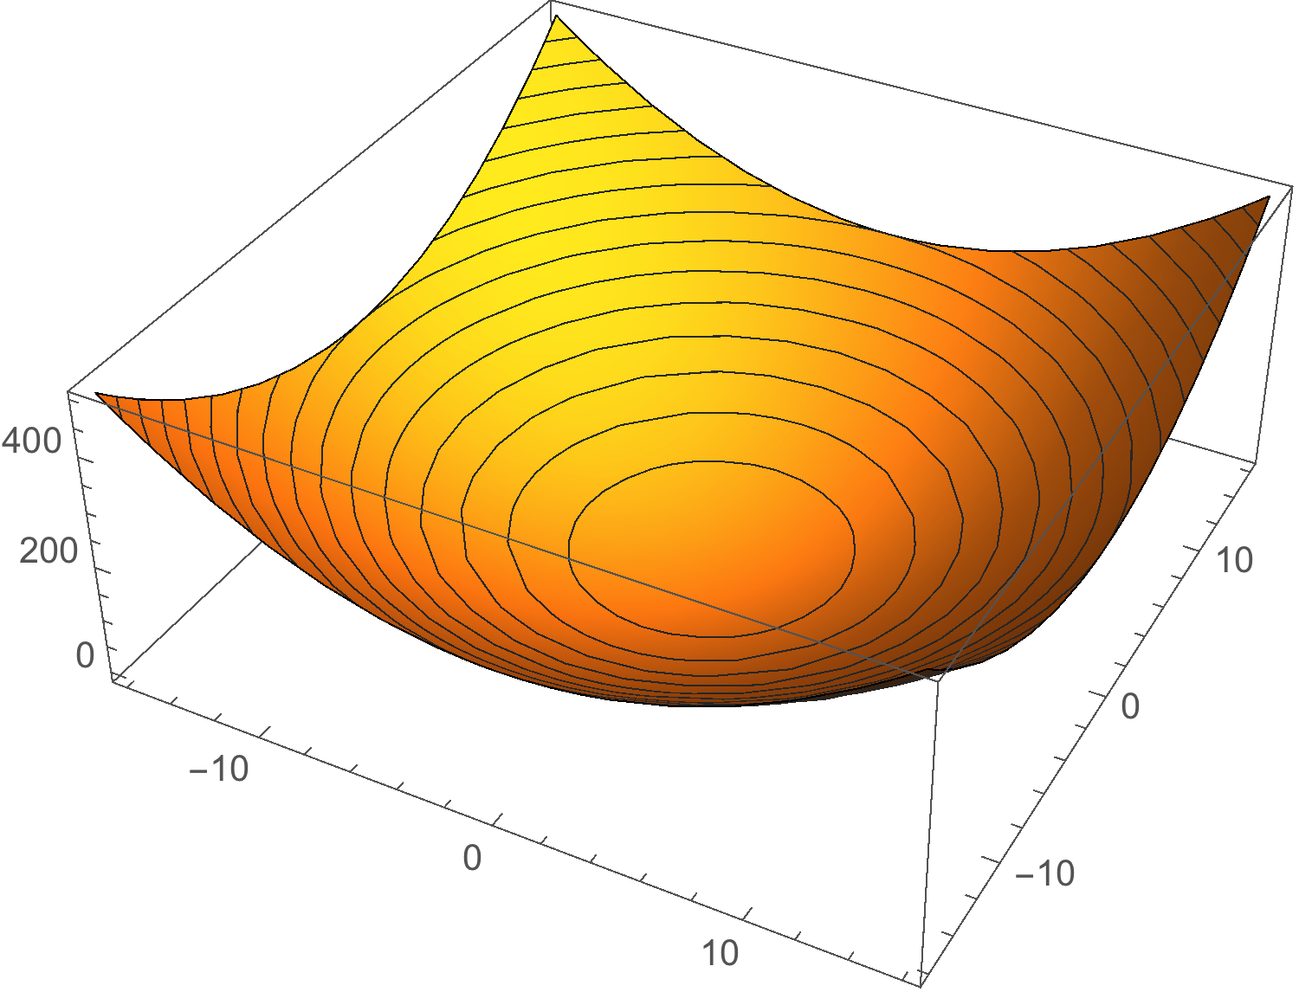
x²+y²=9
z = x²+ y² -9

Slide 35
Double integrals in Polar Coordinate System (PCS)

Slide 36
Double integrals in Polar Coordinate System (PCS)

Slide 37
Double integrals in Polar Coordinate System (PCS)

Slide 38
Double integrals in Polar Coordinate System (PCS)

Slide 39
Double integrals in Polar Coordinate System (PCS)

Slide 42
Changing Cartesian Integral to
Polar Integral

Slide 47
Triple Integrals in Rectangular Coordinate system

Slide 49
Procedure to Find the Limit of Integration
Step-1: Sketch the region D along with its shadow R (Vertical Projection) in any of the plane. Level the boundary surfaces and curves for D and R.
Suppose the region D is bounded above by the graph of z = f₂(x,y) and below by the graph of z = f₁(x,y) and R is the orthogonal projection of D onto the XY-plane for integration

Slide 61
Reference
G. B. Thomas Jr., M. D. Weir,J. R. Hass and C. Heill: Thomas’ Calculus, 13th Edition, Pearson Educations, 2014.

